Slide 1
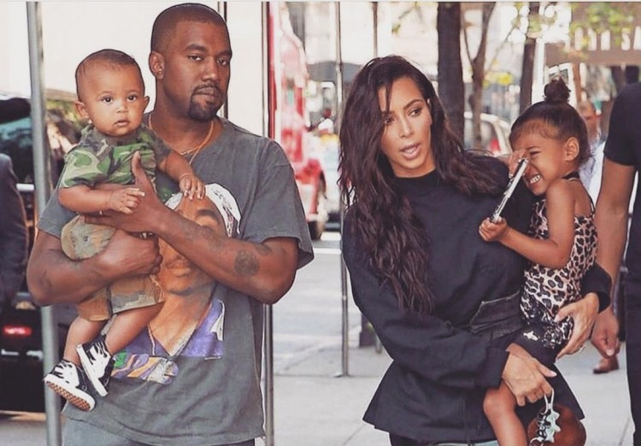
Genetics = the study of heredity
Heredity = how traits are passed from parents to offspring.
Also referred to as
INHERITANCE
Can we predict what traits a child will have based on what their parents look like?

Slide 2
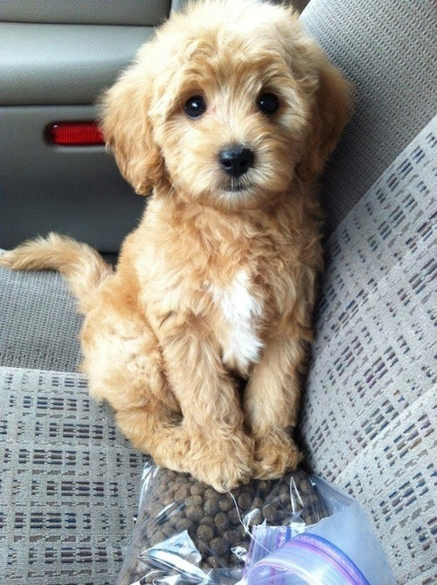
1. A Brief History of Genetics
In the past, people did not understand how traits were inherited, but there were many guesses based on things that could be observed.
Two theories emerged….
Blending Theory - offspring have a mix of traits, somewhere in between
(Straight x curly = wavy)
Particulate Theory - traits are inherited as particles, offspring receive a "piece"
Golden Doodle

Slide 3
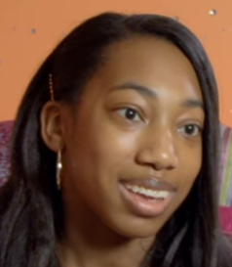
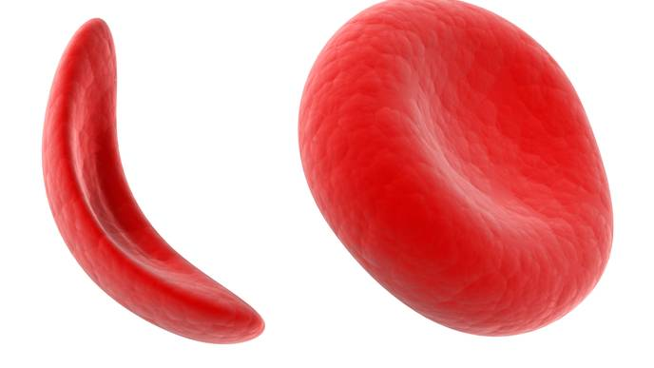
2. Consider Sickle Cell Disease
In many cases, neither parent has the disease, but a child is born with sickle cell.
Does this support the blending theory or the particulate theory?
Recall Alexandria’s Story from last chapter. What caused her to have sickle cell disease? What were her symptoms?

Slide 4
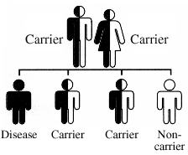
3. In the case of sickle cell, the parents can be carriers.
-They have the GENE that causes the disorder, but they only have one copy.
-The other copy of the gene is normal, they can make normal blood cells.
-You always have 2 copies of a gene, one came from your mother and one came from your father.
-Genes are located on chromosomes, chromosomes occur in pairs.
Abnormal gene
Normal gene

Slide 5
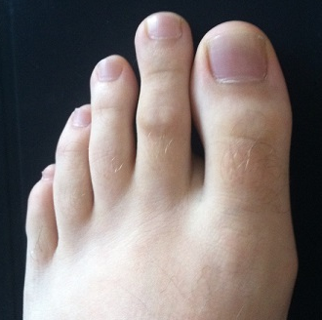
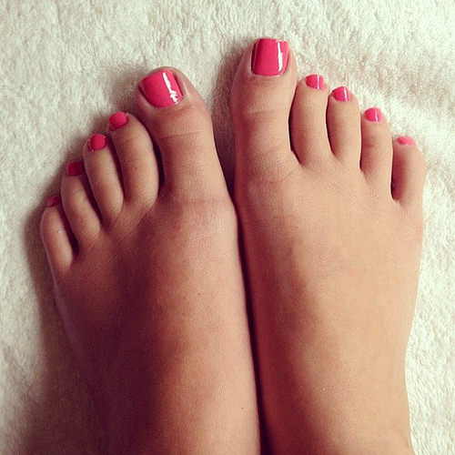
4. Examine the feet below, what do you notice about the second toe?
When we talk about traits we can see, we are referring to the
PHENOTYPE
In other words, phenotype refers to the
APPEARANCE

Slide 6
5. The Short Big Toe Trait
We know that when two people with long big toes have children, they always have children with the same type.
But...if two people with short big toes have children, sometimes they can have a child with the opposite type. Hmmm...
Let’s just call these “weird” toes.
Long big toe
Sketch the short big toe trait:

Slide 7
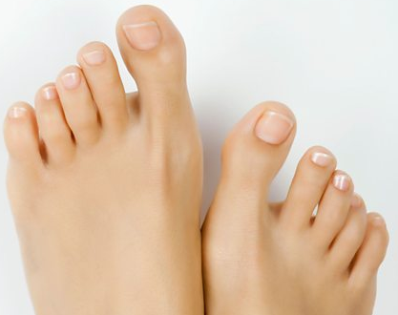
6. Some genes are dominant
In the case of the toe trait, one gene is DOMINANT and can cover up the expression of the other gene.
With feet, the long big toe gene is RECESSIVE.
You need to have both copies of the gene to have this phenotype.

Slide 8
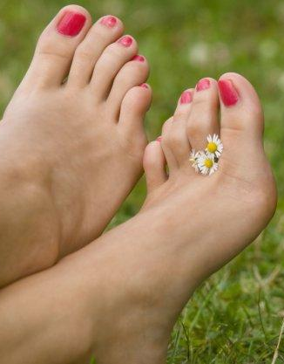
7. A person’s GENOTYPE is the underlying genetic code that determines their traits
- this is based on a long sequence of bases found on DNA
- to simplify, genetics assign LETTERS to genotypes
- because you have two copies of every gene, your genotype will have two letters.

Slide 9
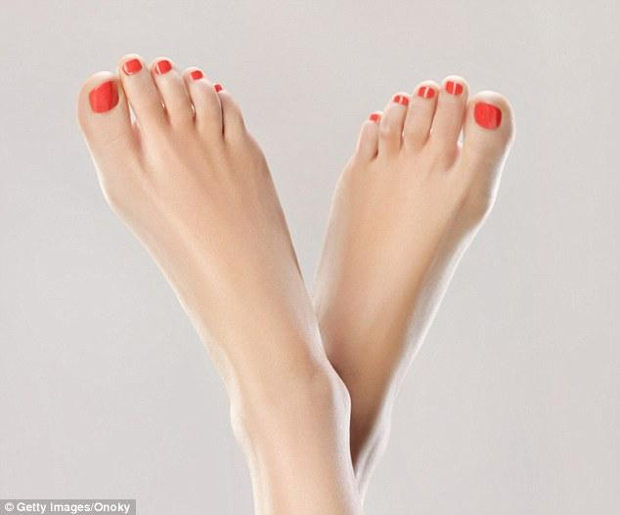
8. Assigning Genotypes
A capital letter is used for the dominant version of the gene and a lowercase letter is used for the recessive version.
T T = short big toe
T t = short big toe
t t = long big toe
What genotype is this person?

Slide 10
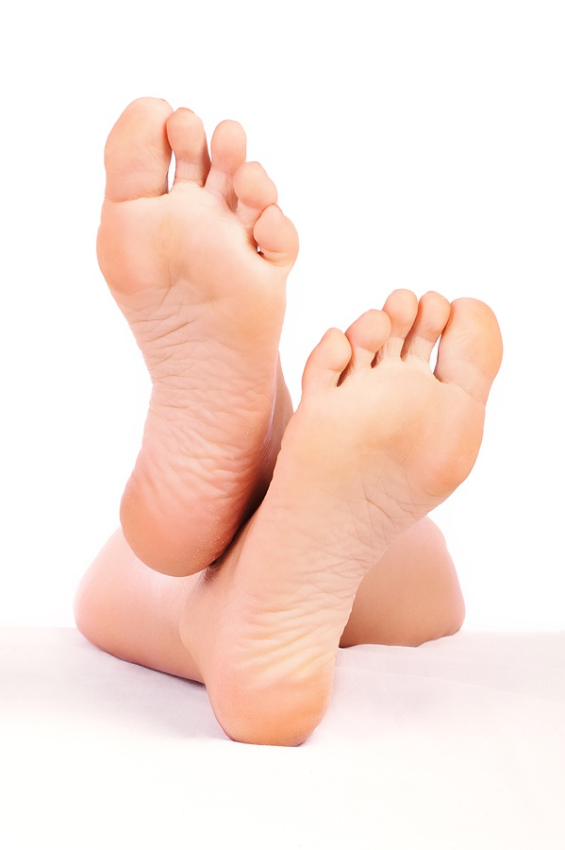
9. Toe Heredity
How can a person have a long big toe (tt) if both of their parents have a short big toe
(TT or Tt)?
First, both of her parents must be carrying the t gene, so her parents’ genotype is Tt
mom
dad
T t x T t
t t
child

Slide 11
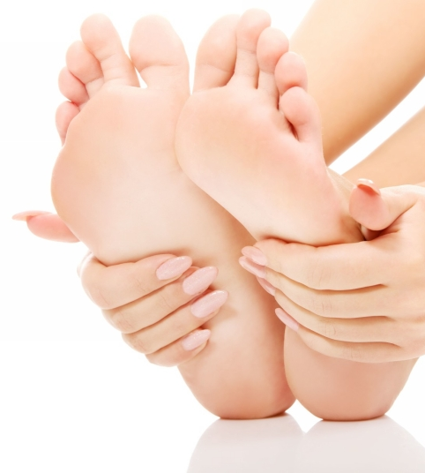
10. What are the odds?
We can make predictions about what phenotypes the offspring will have using a PUNNETT SQUARE
T
t
mom
dad
T
Each box represents a possible offspring.
t

Slide 12
11. Complete the Punnett Square
T
t
mom
dad
T
T T
T t
Each box represents a possible offspring.
t
T t
t t
There is a 1 out of 4 chance this couple will have a child with a long big toes

Slide 13
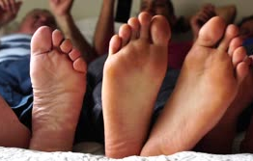
12. The same method can be used to predict the outcome of another cross.
Mom has long big toes ( t t)
Dad has short big toes (T t)
Set up the square….
What percentage of their offspring will take after mom (t t)?
What percentage will take after dad?

Slide 14
13. Alex has sickle cell disease but neither of her parents do.
What are the genotypes of her parents?
________ x __________
Set up a punnett square to show how Alex inherited the disease.
What is the probability (odds) that if Alex had a baby brother, that he would NOT have the disorder?

Slide 15
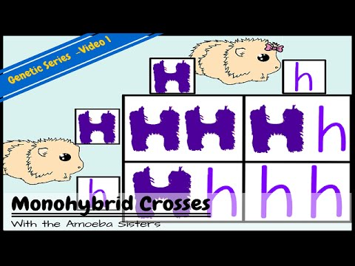
14. Amoeba Sisters - Monohybrid Cross

Slide 16
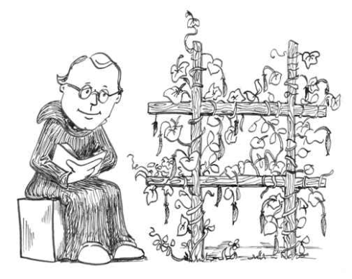
15. A short history lesson
What we know about genetics and probability was established by GREGOR MENDEL
He is known as the “Father of Genetics.”
He did experiments on pea plants where he learned about the principles of dominance and recessiveness and how traits are passed through each generation.

Slide 17
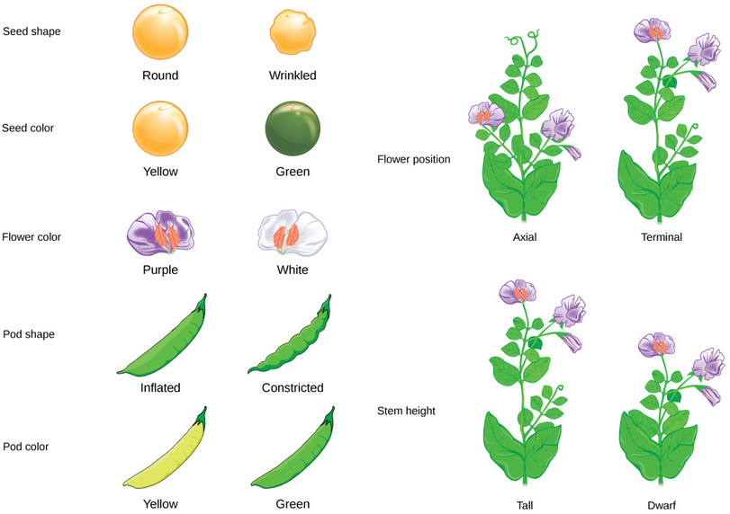
16. Traits in Pea Plants
Seed Shape
Seed Color
Flower Position
Flower Color
Pod Shape
Stem Length
Pod Color

Slide 18
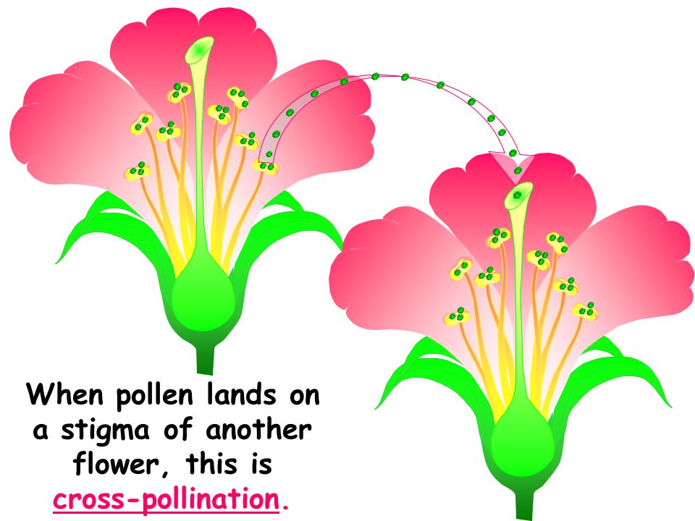
17. Plant Sex
Pea plants can be self-fertilized or cross-fertilized
This helped Mendel figure out that some traits were hidden, he later called these hidden traits “recessive.”

Slide 19
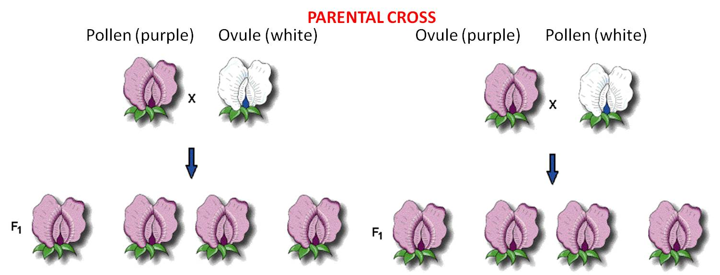
18. True-Breeding Plants -always create plants that look like the same
Hybrids – offspring of true-breeding plants
PP
pp
HYBRIDS
Heterozygous = when individual has one of each type of gene
Pp
Pp
Pp
Pp

Slide 20
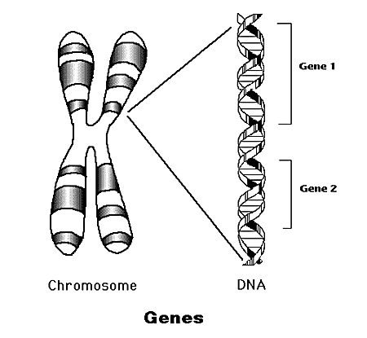
19. Mendel discovered that each trait is controlled by two factors (alleles)
Genes – factors that determine your traits, composed of 2 alleles
Genes are located on chromosomes

Slide 21
Quick Check - What do we know so far?
1. The “Father of Genetics” is ____________
2. Genetics is the study of _____________, which is how traits are passed from _________ to ____________
3. Mendel studied what organism? ____________
4. If one trait covers up another one,
we say that it is _____________________,
the one that is covered up is ___________________
5. A “true-breeding” plant is one that can only produce plants like itself a) true b) false
6. If a tall and a short plant are crossed, it will create a
a) zygote b) gene c) hybrid

Slide 22
Check for understanding
1. Genes are located on _______________
2. Every gene is made of two a. genotypes b. alleles c. cells
3. The organism’s outward appearance, such as wrinkled seeds are referred to as the a) phenotype b) genotype
4. The letters (ex. RR) that represent the traits are referred to as the
a) phenotype b) genotype
5. An organism that has two different alleles, or letters, such as Rr is:
a) homozygous b) heterozygous
6. 7. An organism that has two of the same alleles, or letters, such as RR is:
a) homozygous b) heterozygous

Slide 23
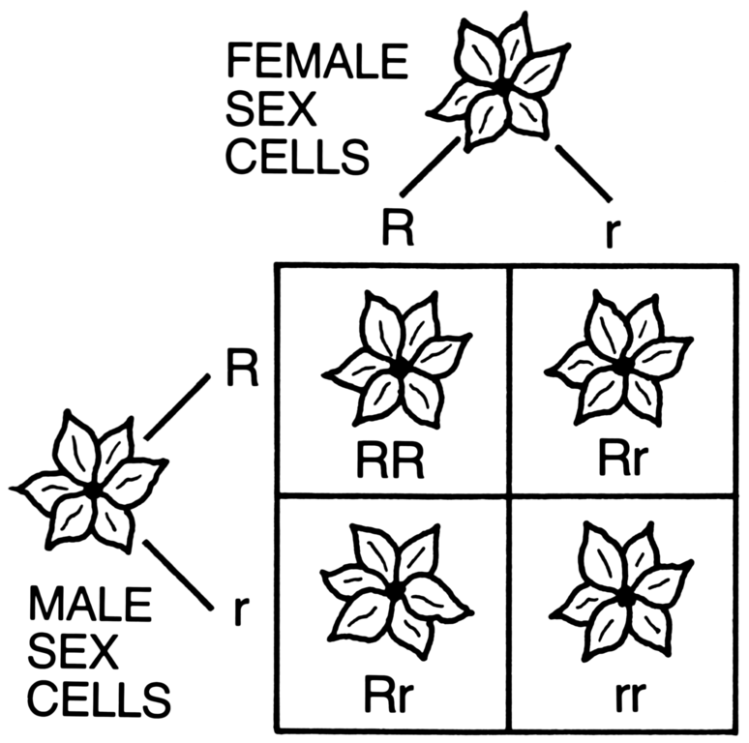
1. What is the diagram shown below called? _____________________
If the trait studied here is red leaves, which is dominant. How many offspring of this cross will red leaves? ______

Slide 24

2. A one-eyed purple people eater is crossed with a two eyed purple people eater. All of their offspring have two eyes. Which trait is dominant?
3. If you use the letter E for this gene. What is the genotype of the offspring if the parents were
EE x ee
4. If you crossed the offspring with each other (Ee x Ee) ? How many of the new offspring would you expect to have two eyes?
EE = two eyes
Ee = two eyes
ee = one eye

Slide 25
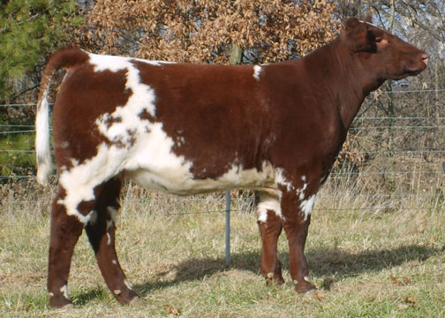
20. There are other types of crosses...
If you cross a red cow with a white cow, you get offspring that are red and white, a condition called ROAN.
This is called codominance, because neither allele covers up the others and both are expressed.
RR = Red Cow
RW = Roan Cow (heterozygote)
WW = White cow

Slide 26
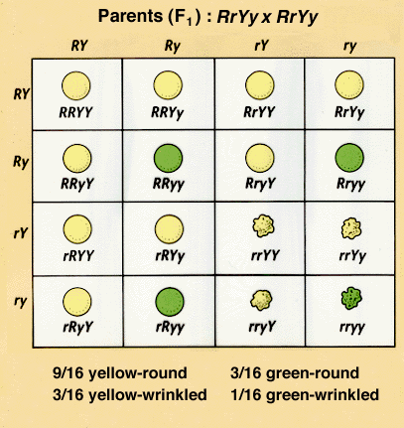
22. DIHYBRID CROSSES - involve 2 traits
- RrYy x RrYy
You can predict the outcome using a larger punnett square.
Notes:
https://www.biologycorner.com/worksheets/genetics_2traits_bio2.html - rabbits
https://drive.google.com/file/d/0Bx72aSXCBO09MHEybjFJeXJ5UEk/view - guinea pigs

Slide 27
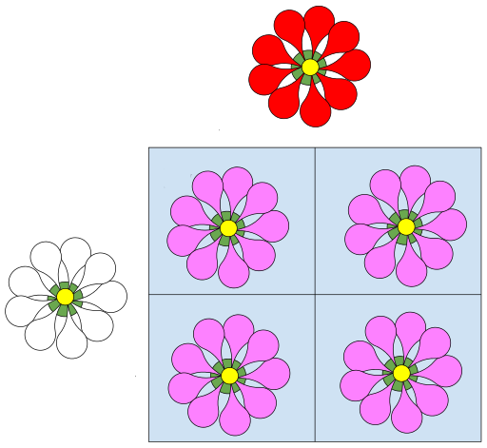
23. Incomplete Dominance
white x red flower = pink flowers
RR = red
RW = pink
WW = white
What would happen if two pink flowers were crossed?

Slide 28
24. Multiple Allele Traits - more than two alleles control the trait
Example: Blood Type
Blood Type | Genotype
A | AA, AO
B | BB, BO
AB | AB (codominant)
O | OO (recessive)
Show the cross between:
AB x O AO x BO O x O

Slide 29
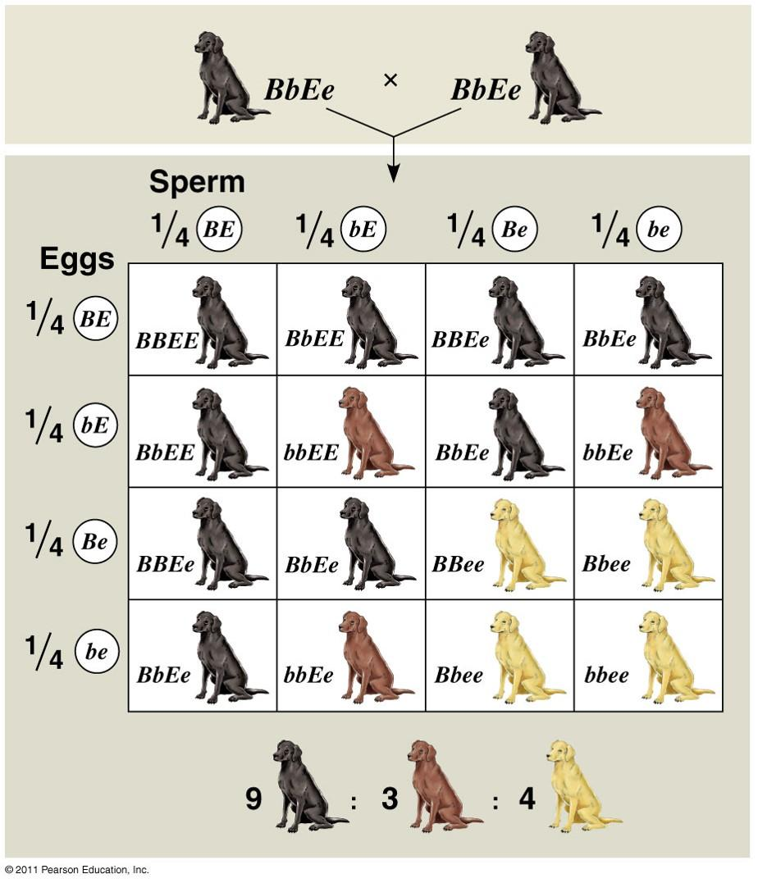
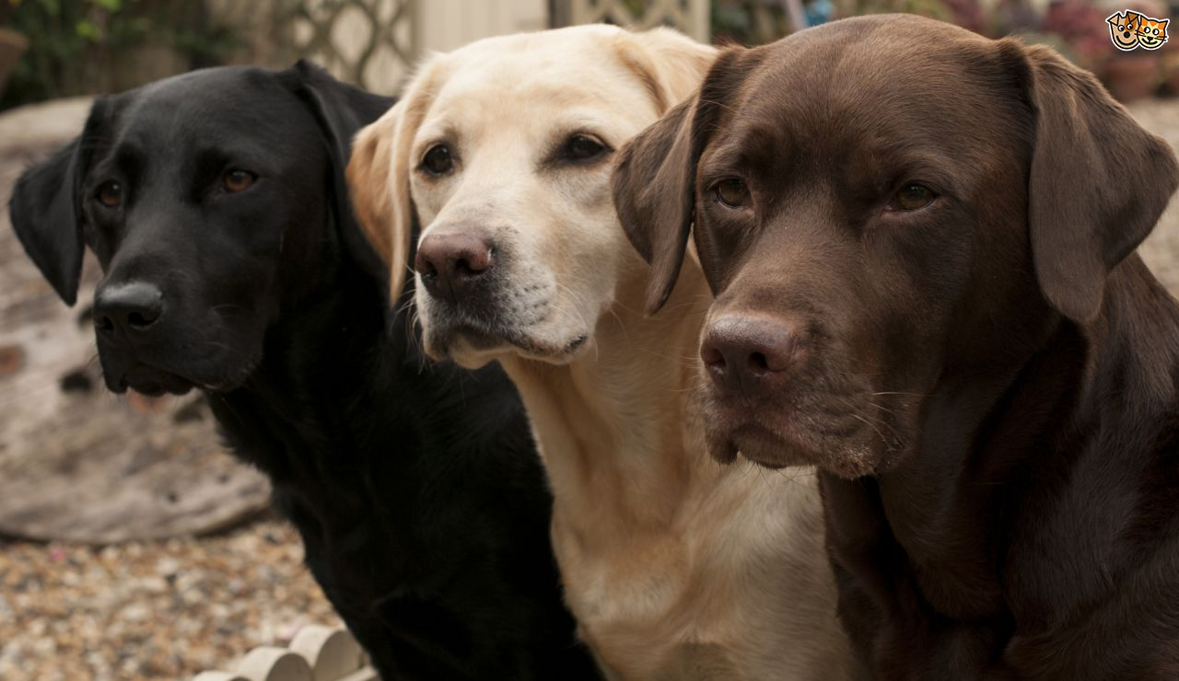
25. Epistasis - Sometimes a set of alleles can cover up another set.
Example: coat color in labrador retrievers

Slide 30
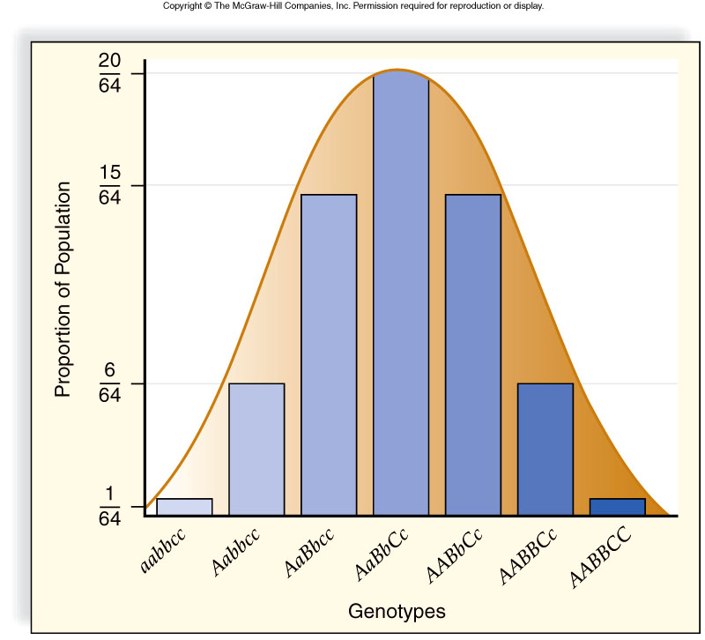
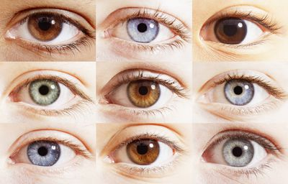
26. POLYGENIC TRAITS - when many genes control one trait, usually resulting a wide RANGE of phenotypes
Examples: Skin color, height, eye color (human)

