Slide 1
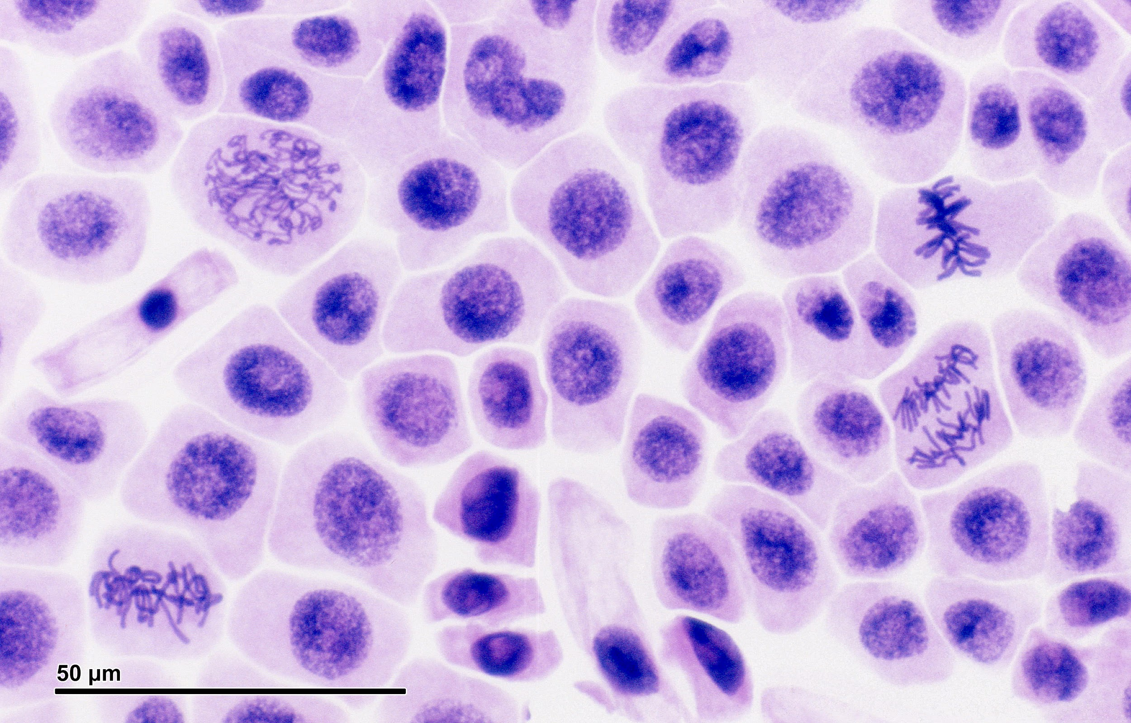
Explore…. What is this image? What do you know about it already?
Notes:
Printable image from Wiki: https://docs.google.com/document/d/1lxnNFxvzONOqaMq9dEU__1mk-07M6DY0yKFvGXBYwhA/edit?usp=sharing. Have students annotate everything they know about the image, a good way to refresh their memory about mitosis and see what they already know. I create laminated versions of this image for them to annotate.

Slide 2
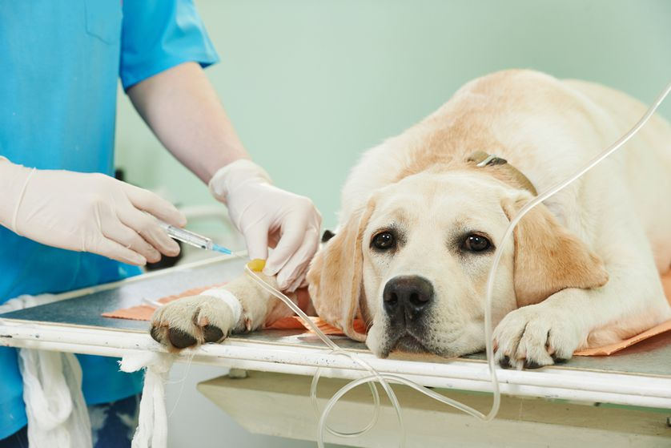
CAPTION THIS PHOTO.
Notes:
25 minute video at https://www.mnn.com/family/pets/stories/dogs-humans-cancer-comparitive-oncology

Slide 3

Cell Division and Cancer
“Humans and dogs are 95 percent identical genetically — and the diseases that affect humans including breast cancer, prostate cancer, and melanoma are almost identical."
NBC News
1. Watch short video: Could Dogs Hold the Key to Curing Cancer? (2 min)

Slide 4
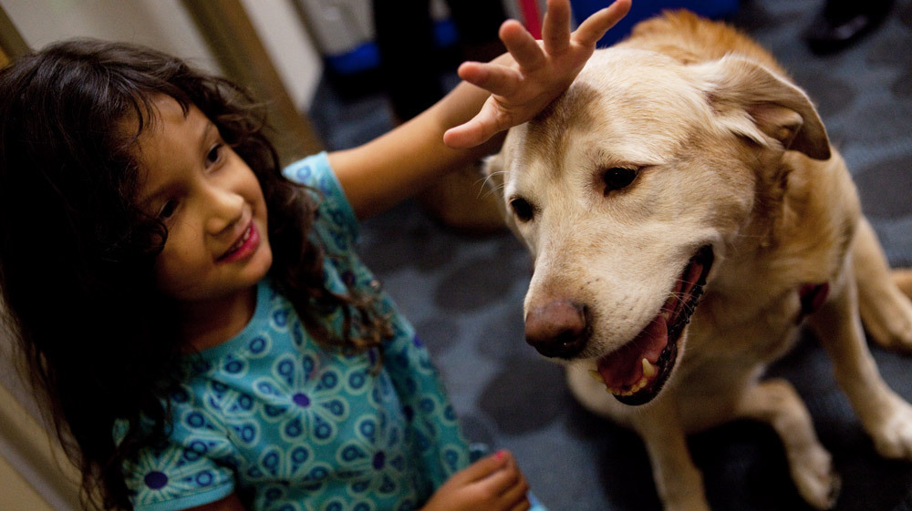
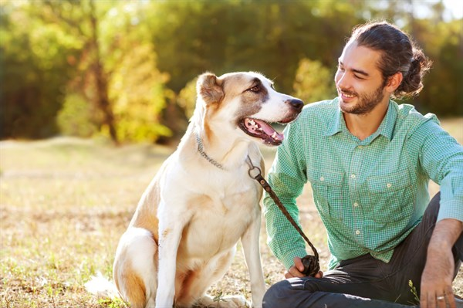
2. Dogs are also good MODELS for cancer studies because they live closely with humans. Things that cause cancer in humans cause cancer in dogs.
What are the different types of cancer you have heard of.
Are they all the same?
Are some worse than others?

Slide 5

3. Mini - Group Discussion (~ 10 minutes)
a. Do you know anyone who has cancer or who has died of cancer? Describe your experiences and share with the group. What are some experiences people have in common?
b. Why do you think it’s difficult to cure cancer?
c. If your dog had cancer, would you give treatment (amputation, chemotherapy, radiation)? Explain your position.
Have one person summarize your group’s responses to turn in.

Slide 6

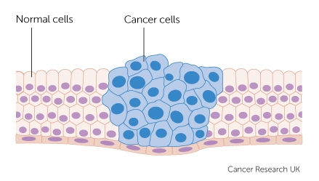
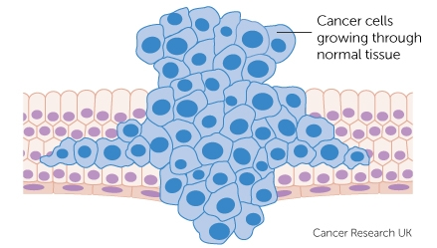
4. What exactly is cancer?
A doctor who specializes in cancer is called an ONCOLOGIST.
Cancer occurs when cells of your body begin to divide uncontrollably and form a tumor.
If the tumor stops growing, it is called BENIGN.
If the tumor continues to grow, it is called MALIGNANT.
Notes:
Notes aligned with Biology by OpenStax

Slide 7
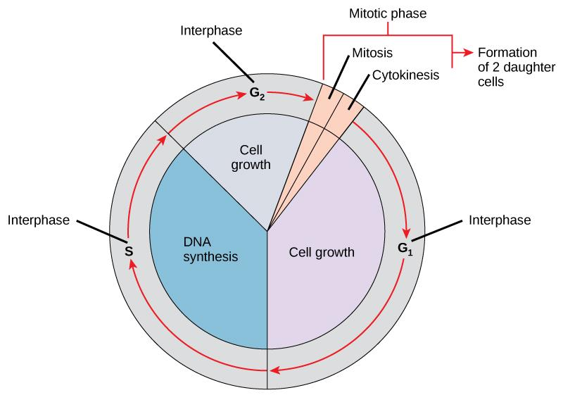
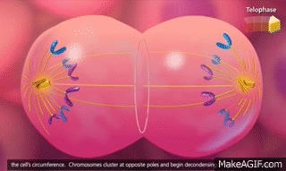
5. Cancer is a disorder of the CELL CYCLE.
-Cells divide as you grow and repair tissues.
-Each new cell needs to be an exact copy of the original.
-If there are errors in the process, a cell may become cancerous.

Slide 8
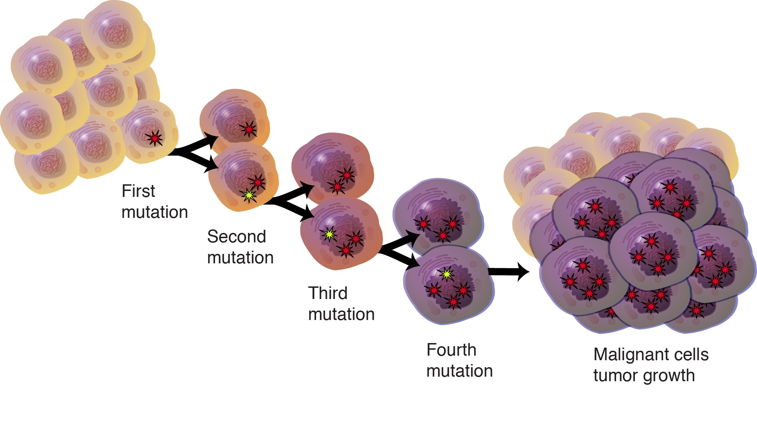
6. Why do cells become cancer cells?
The answer is in your genes, or your DNA.
Genes control all of your traits
Mutations in genes can lead to cancer.
We’ll explore how this happens and why.
If we can establish the causes of cancer, we can find ways to treat cancer.

Slide 9
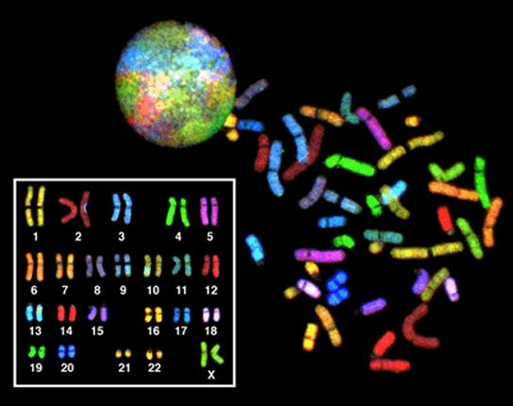
46 chromosomes
7. Chromosomes
- structures in the nucleus that contain DNA
- sections of DNA make up genes
Humans have 46 in every cell except sperm and eggs.
Dogs have 72

Slide 10
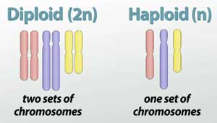
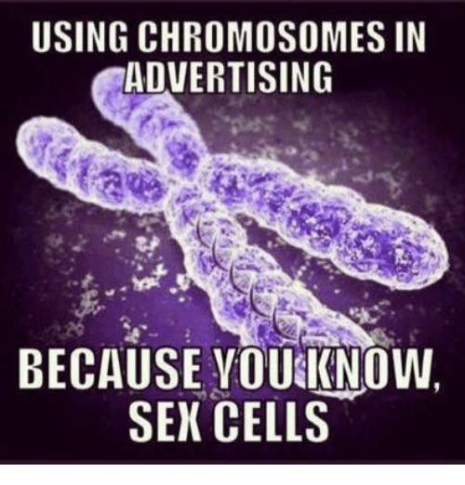

8. Types of Cells in the Body
Diploid - cells that have both sets, body cells
Haploid - cell that have only 1 set (half), sex cells

Slide 11
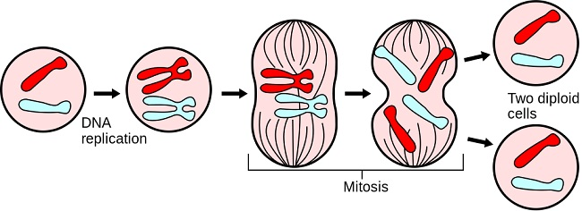
9. Why do cells divide?
Your body cells divide as you grow
They divide when you need to repair tissue
They divide to replace worn-out cells.

Slide 12
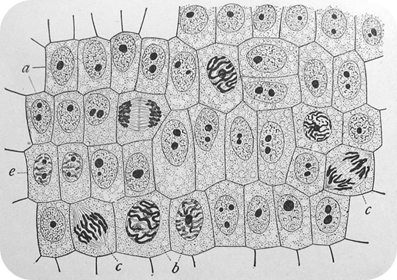
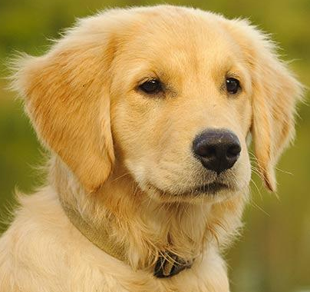
10. Cell spend most of their life in INTERPHASE
- during this time, cells grow and perform functions
- DNA makes a copy
Most of the cells in this image are in interphase.
Notes:
Golden retrievers are being used as models because their breed has the highest rates of cancer.

Slide 13
11. Chromosome Structure
- chromosomes are found in the nucleus
- made of identical sister chromatids
- held together by a centromere
Chromatid
Nucleus
Cell Membrane
X
X
Centromere
X
X
DNA
Chromosomes
Notes:
Golden retrievers are being used as models because their breed has the highest rates of cancer.

Slide 14
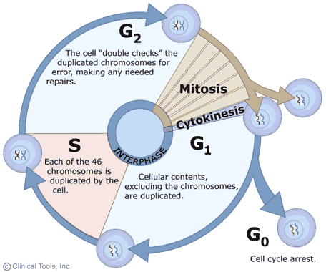
12. Cell Cycle Phases
Interphase - DNA copies, cell activities and growth,usually longest phase
Mitosis - The division of the nucleus, ~ 12 hours
Cytokinesis - The division of the cytoplasm that results in two daughter cells

Slide 15
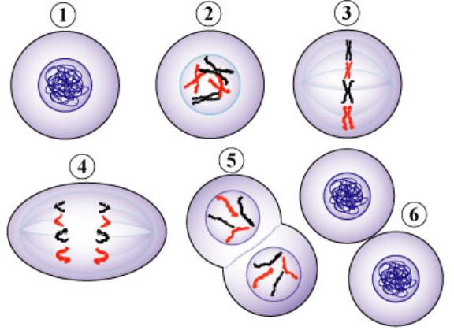
13. Phases of Mitosis → IPMAT
1. (Interphase)
2. Prophase
3. Metaphase
4. Anaphase
5. Telophase
(6. Cytokinesis)

Slide 16
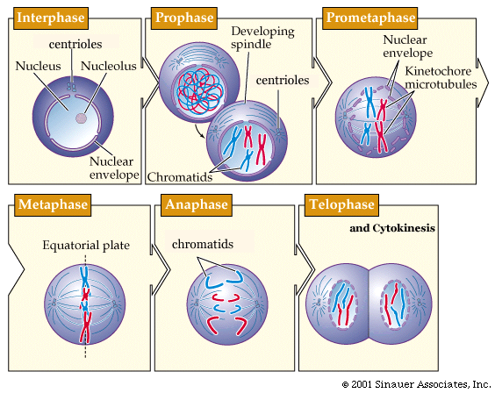

Slide 17
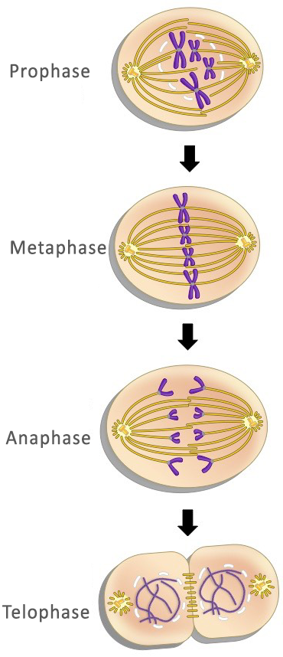
14. What happens during each phase?
Prophase: Chromosomes visible, spindle forms as centrioles move
Metaphase: Chromosomes line up along equator
Anaphase: Chromatids separate
Telophase: Nuclear membrane forms, cytokinesis begins

Slide 18
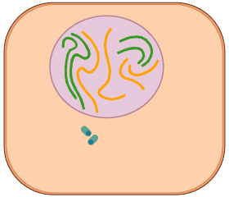

Slide 19
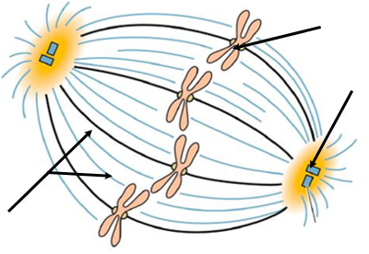
15. What is the role of the spindle in mitosis?
- fibers anchored to the centrioles
- attaches to the centromeres
- moves chromosomes
chromosome
centromere
centriole
spindle

Slide 20

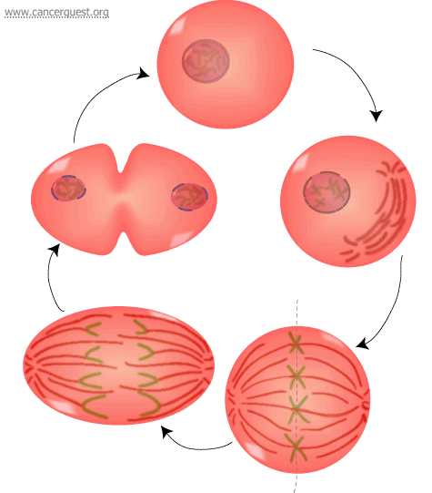
Check Yourself
Name the phases starting at the top.

Slide 21
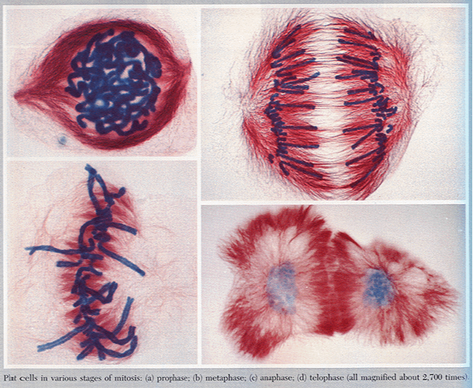
Identify the phases.

Slide 22
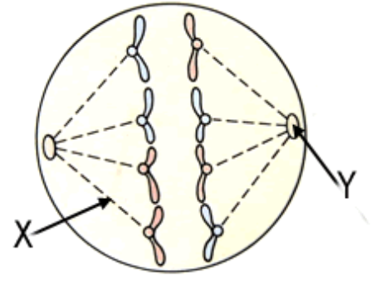
Name the phase
Identify X
Identify Y

Slide 23
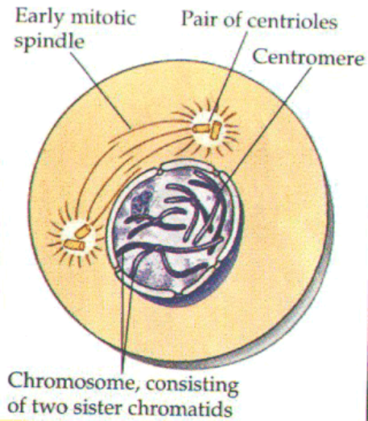
Name the phase.

Slide 24
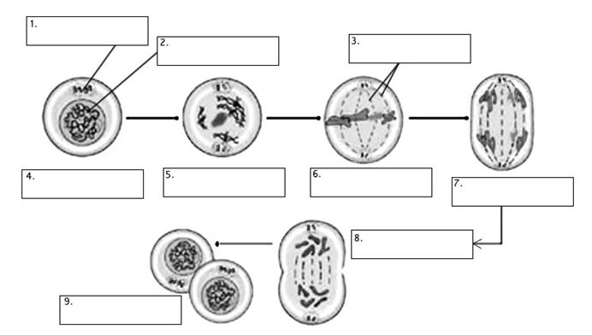
Quick Check
Word Bank
Spindle
Centrioles
Chromatin
Interphase
Prophase
Metaphase
Anaphase
Telophase
Cytokinesis
1. In humans, each cell (except sex cells) has how many chromosomes? ______
2. After mitosis, how many daughter cells are produced? _______
3. After mitosis (in a human cell), each daughter cell has how many chromosomes? _____
4. How many phases are in MITOSIS? ___________
5. Which phase of the cell cycle is the longest? _________
6. During which phase does cytokinesis begin? __________

Slide 25
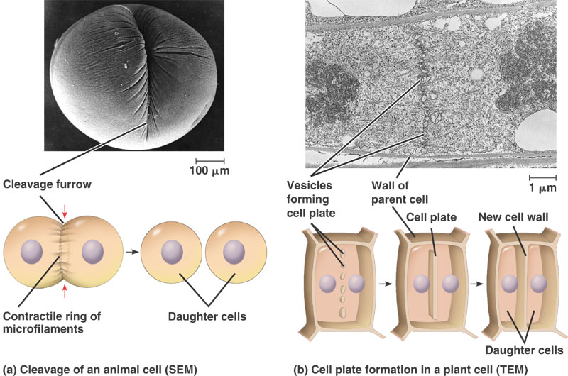
16. Cytokinesis in Plants and Animals
Animal cells pinch inward to make daughter cells
Plants cells build a new cell wall.

Slide 26
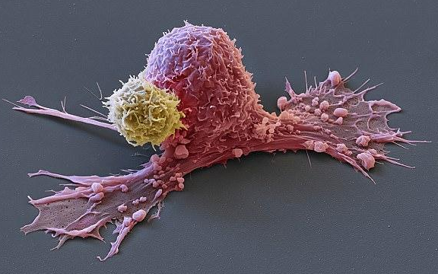
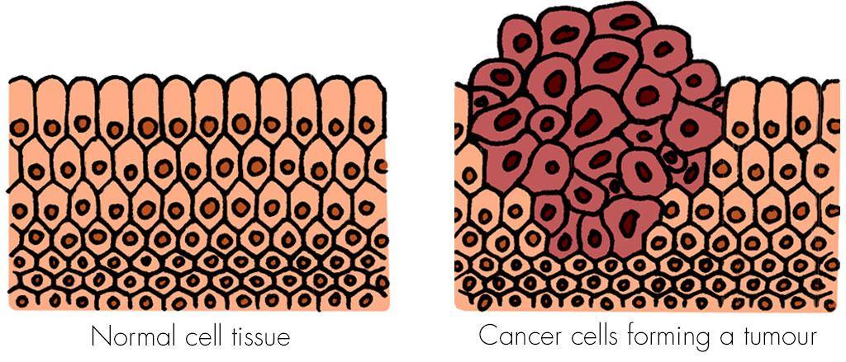
17. Cancer
- results when DNA is copied with an error during interphase.
- That error prevents the cells from knowing when to stop dividing.
Metastasis = malignant growths that occur a distance from the primary site of cancer

Slide 27
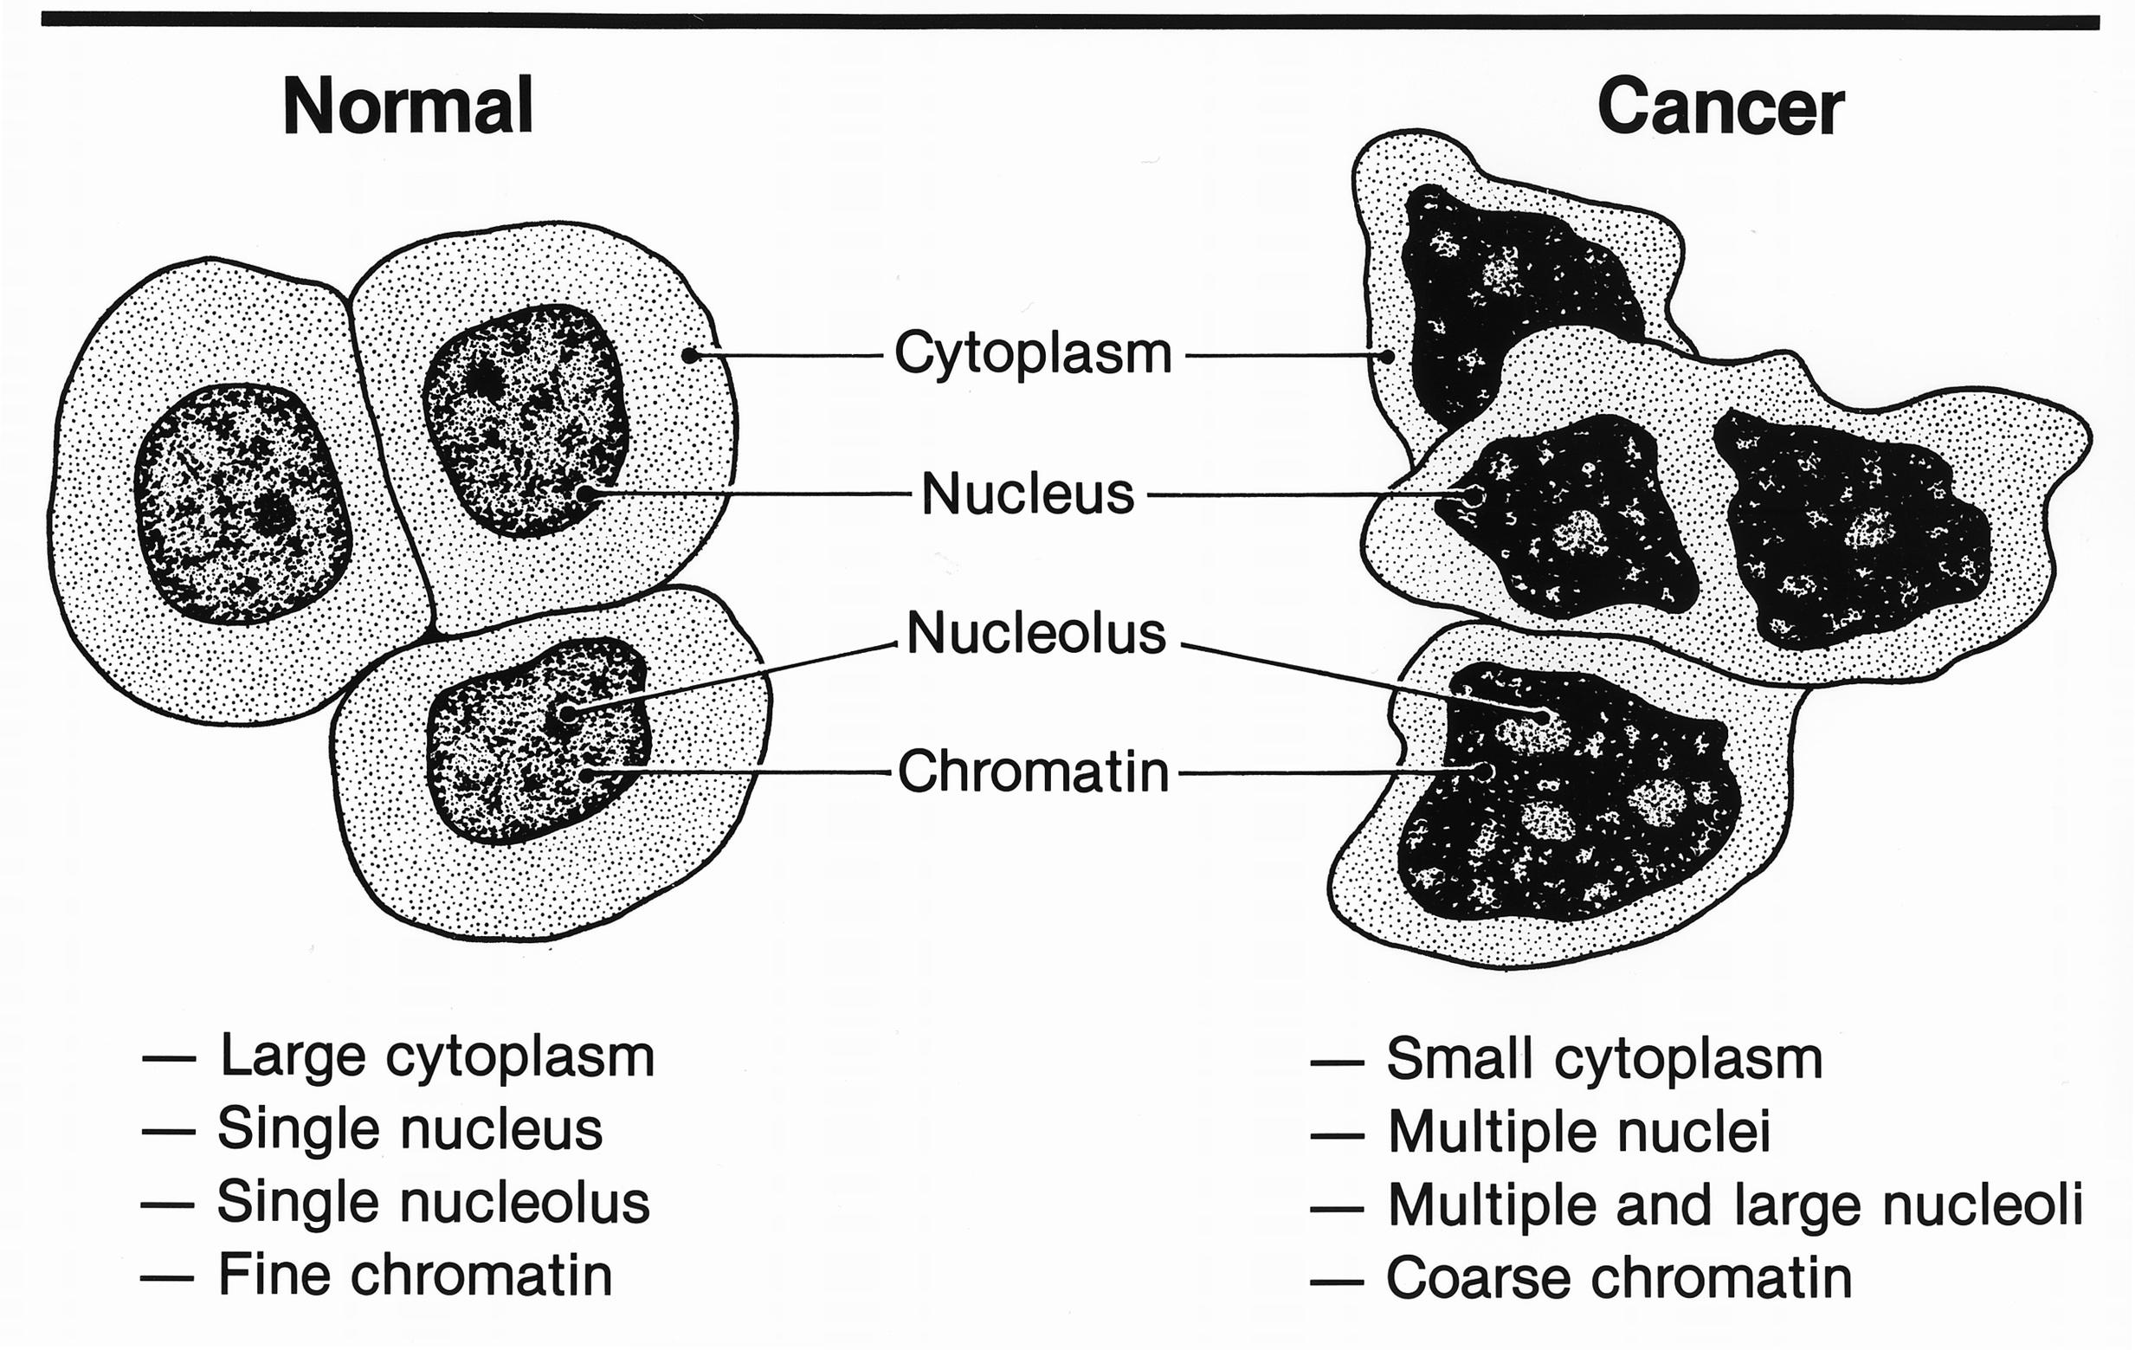
18. Comparing Normal Cells to Cancer Cells

Slide 28
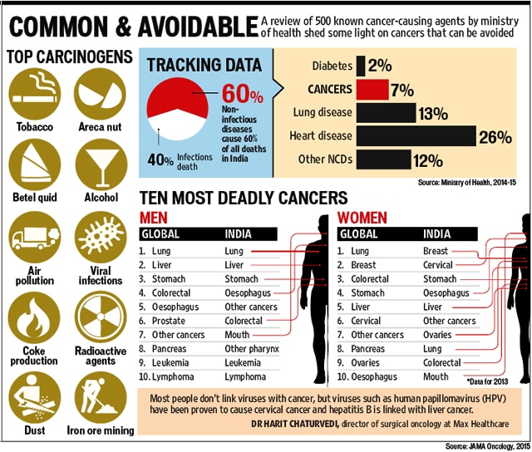
19. Why do errors happen?
--DNA is damaged by chemicals called CARCINOGENS.
-When you are exposed to these chemicals, your risk of cancer increases.
Some examples:
Smoking
UV radiation (sunlight)
Some pesticides
Asbestos

Slide 29
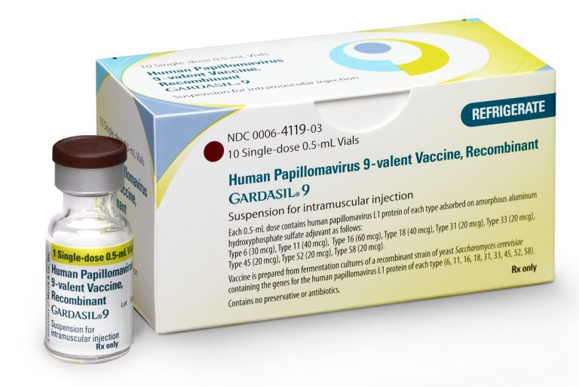
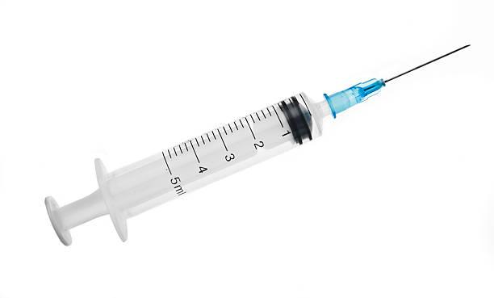
20. Can you catch cancer?
-Cancer is not contagious, but some VIRUSES can cause cells to become cancerous.
-HPV or Human Papillomavirus Virus has been linked to cervical cancer.
-A vaccine to protect you from HPV can reduce the chance of cervical cancer.
Should schools require students to get an HPV Vaccine, why or why not?
Should boys get this vaccine?

Slide 30
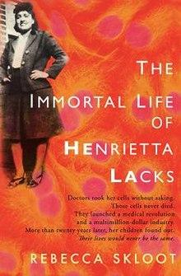
HeLa Cells
Article on Henrietta Lacks
-A HeLa cell is a cell type in an immortal cell line used in scientific research.
-Cells were from cervical cancer cells taken from Henrietta Lacks, a patient who eventually died of her cancer on October 4, 1951.
For fun: what would the name of your immortal line of cells be? (First two letters of your first name + first two letters of your last name.)

Slide 31
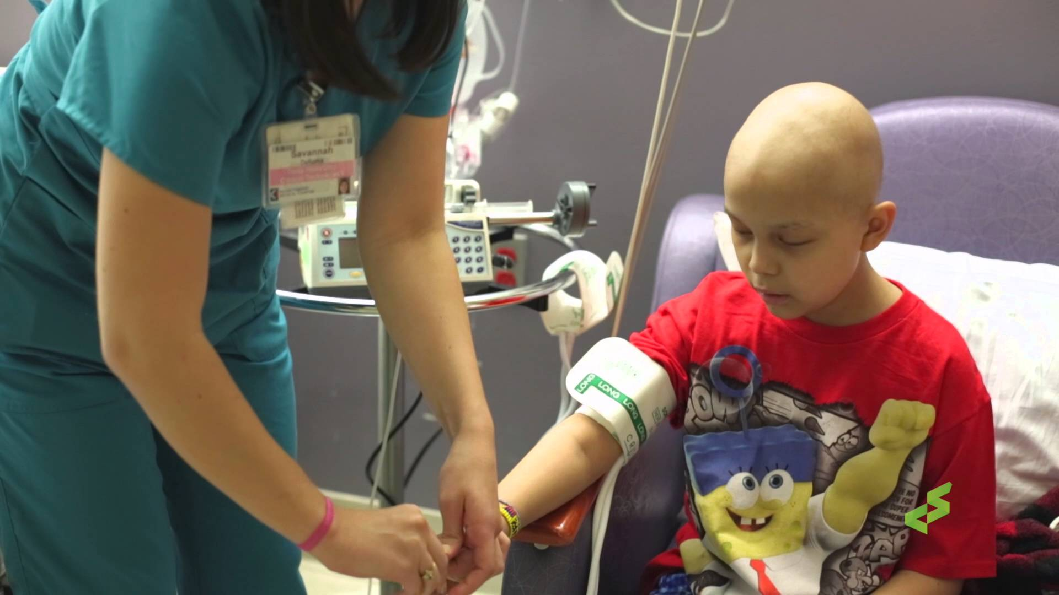
22. How Do We Treat Cancer?
-Chemotherapy = Drugs stop the replication of DNA or stop spindle fiber formation
-These chemicals also damage healthy cells, which is why patients may lose their hair.

Slide 32
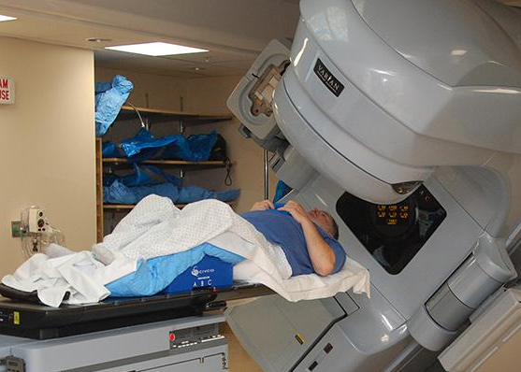
23. Radiation treatments
- target the tumor directly and destroy the cells
- It can also destroy healthy cells

Slide 33
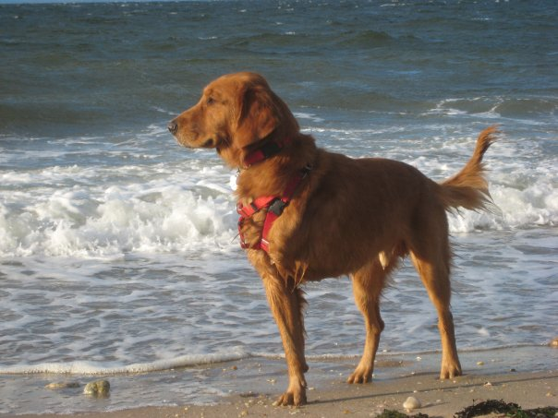
24. Tissue Removal
-Doctors may remove the tissue that is cancerous, such as an amputation of
- women with breast cancer may have a mastectomy
Osteosarcoma is bone cancer, common in golden retrievers.
Usually treated by amputation.

Slide 34
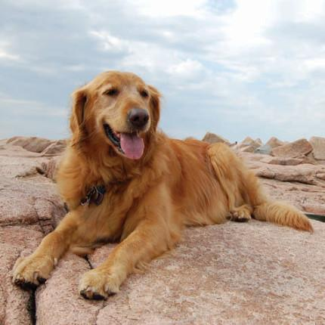
Exit Ticket:
1. Why do you think it’s difficult to cure cancer?
2. Some individuals make claims that there is a cure for cancer but it is being hidden to keep more people sick. Given what you know about cancer, do you think this is likely? Why or why not?
3. Why are dogs useful models for studying cancer in humans?

Slide 35
