Slide 1
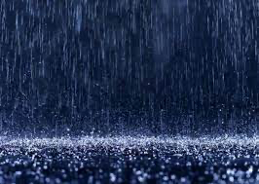
Acid Rain
Hunter Henrickson

Slide 2
Description
Acid rain, or acid deposition, is a broad term that includes any form of precipitation with acidic components, such as sulfuric or nitric acid that fall to the ground from the atmosphere in wet or dry forms. Acid rain can form from snow and rain fog and other weather.(1)

Slide 4
Causes and effects
Rotting corpse and vegetation gives dioxide and is turned into acid rain(2)
Acid rain results when sulfur dioxide (SO2) and nitrogen oxides (NOX) are emitted into the atmosphere and transported by wind and air currents, and can cause acid rain(3)
humans have released so many different chemicals into the air(4)

Slide 5
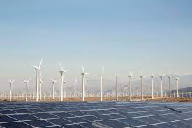
Solution
renewable energy sources(5)
Stop burning fossil fuels(6)

Slide 6
1. https://www.epa.gov/acidrain/what-acid-rain#:~:text=Acid%20rain%2C%20or%20acid%20deposition,even%20dust%20that%20is%20acidic.
2. https://www.nationalgeographic.com/environment/article/acid-rain#:~:text=Causes%20of%20acid%20rain,plants%2C%20factories%2C%20and%20automobiles.
3. https://www.epa.gov/acidrain/what-acid-rain
4. https://www3.epa.gov/acidrain/education/site_students/whatcauses.html
5. https://www3.epa.gov/acidrain/education/site_students/beingdone.html#:~:text=A%20great%20way%20to%20reduce,they%20produce%20much%20less%20pollution.
6. https://www3.epa.gov/acidrain/education/site_students/beingdone.html#:~:text=A%20great%20way%20to%20reduce,they%20produce%20much%20less%20pollution.

